Slide 1
Week 5 Lab
- Lab Tasks - Class Test 1 Description

Slide 2
Today’s Lab Tasks
def sendOnePing(icmpSocket, destinationAddress, ID):
# 1. Build ICMP header
# 2. Checksum ICMP packet using given function
# 3. Insert checksum into packet
# 4. Send packet using socket
# 5. Record time of sending
pass # Remove/replace when function is complete
def doOnePing(destinationAddress, timeout):
# 1. Create ICMP socket
# 2. Call sendOnePing function
# 3. Call receiveOnePing function
# 4. Close ICMP socket
# 5. Return total network delay
pass # Remove/replace when function is complete
def ping(host, timeout=1):
# 1. Look up hostname, resolving it to an IP address
# 2. Call doOnePing function, approximately every second
# 3. Print out the returned delay
# 4. Continue this process until stopped
pass # Remove/replace when function is complete

Slide 3
Class Test 1 Description
Four types of Questions.
5 MCQs (Single Correct Option)
5 True/False
5 Select Correct Missing Words
5 MCQs (Multiple Correct Options)

Slide 4
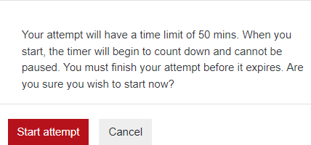
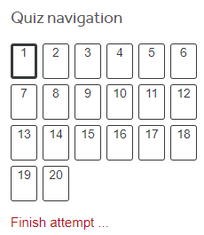

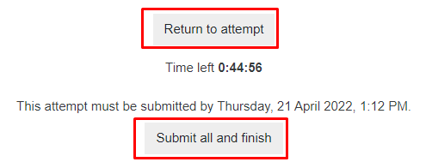
Instructions
Total 20 Questions
Time limit is 50 Minutes
Login Moodle and Click on following Link
Go to Class Test 1
Click on Button
Click on Start Attempt (Only one attempt is allowed)
During Test you can go back and forth with Quiz Navigation
you shouldn’t click Finish attempt.
If you click on Finish attempt, then you have options to
either Return to Attempt or Submit all and finish
If you do not finish your class test in 50 mins then the questions
completed so far will be automatically submitted for marking
Don’t talk to each other and don’t open any other Window (except Class Test 1)

Slide 5
Examples
ICMP stands for ____________________.
Internet Control Message Protocol
Internet Configuration Management Protocol
Internet Core Management Protocol
Why there is need for TTL?
To avoid routing loop
To expiration date for updates
Both A and B
None of the above
If TTL is 250 in Ping, it means packet will be recieved after 250 ms?
True
False

Slide 6
Examples
Which module of python required for network programming?
Packet
Socket
Network
What is a socket?
IP Address + Port Number or IP address + Port No. + Application No.
How I can create a server socket?
Socket = severSocket(“localhost”, 1055)
Server = socket (“localhost”, 1055)
Client = socket (“localhost”, 1055)

Slide 7
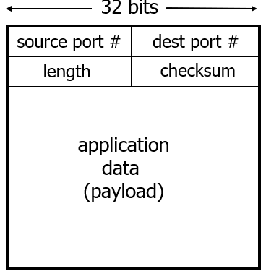
Examples
This is format of _______ packet.
UDP
TCP
HTTP
Internet Checksum is _______ protection.
Strong
Weak
TCP is connection-oriented; it means it provides delay guarantees
True
False
__________ uses header info to deliver received segments to correct application.
Multiplexing
Demultiplexing
IP routing
Frame delivery

